Slide 1
Compression

Slide 2
Bert 비교군 정리
I-BERT: Integer-only BERT Quantization

Slide 3
Compressing Large-Scale Transformer-Based Models: A Case Study on BERT
Survey paper on compression methods specialized at BERT

Slide 4
I-BERT: Integer-only BERT Quantization
Quantization in to int8
2.4-4.0x inference time compared to RoBERTa-Base/Large
Accuracy increase 0.3~0.5 points

Slide 5
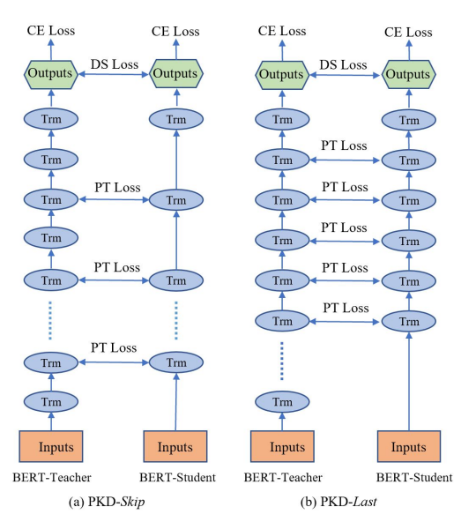
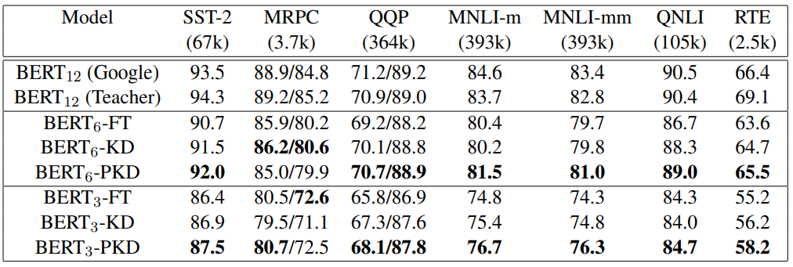
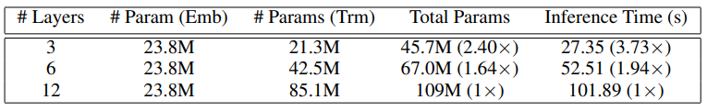
Patient Knowledge Distillation for BERT Model Compression
Two types of patient knowledge distillation approach for BERT

Slide 6
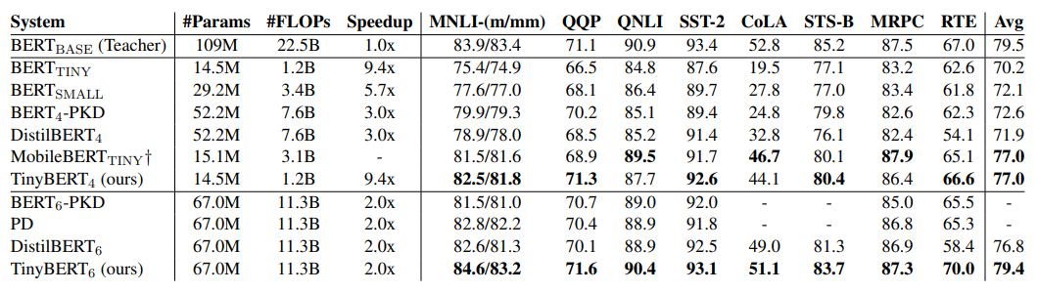
TinyBERT: Distilling BERT for Natural Language Understanding
Transformer Distillation

Slide 7
DistilBERT, a distilled version of BERT: smaller, faster, cheaper and lighter

Slide 8
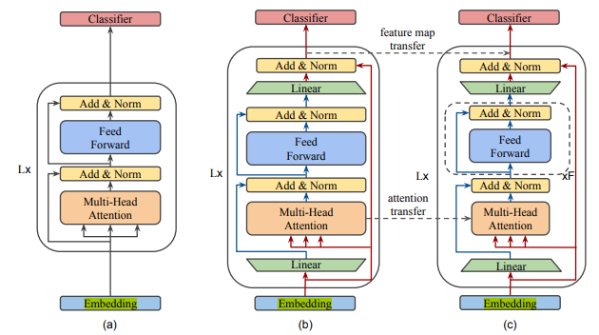
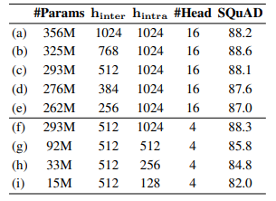
**MobileBERT: a Compact Task-Agnostic BERT for Resource-Limited Devices
모델 구조 변경
Embedding layer에 1D conv를 사용
Attention Transfer(KL div), feature map(MSE) transfer사용
hIntra 사이즈 크기의 중요성
Head사이즈는 줄여도 성능 방어
Embedding size1024 -> 128
참고 :
MobileBERT (brunch.co.kr)

